Slide 1
18CSC205J - OPERATING SYSTEMS
UNIT-1
Session-9,10
SLO 1,2-Understanding the Linux File System
SRM Institute of Science and Technology, Ramapuram

Slide 2
Understanding the Linux File System
Objective: To study various Linux file system and file system structure.
Linux File System
Linux File System or any file system generally is a layer which is under the operating system that handles the positioning of your data on the storage, without it; the system cannot knows which file starts from where and ends where.
Linux offers many file systems types like:
Ext: an old one and no longer used due to limitations.
Ext2: first Linux file system that allows 2 terabytes of data allowed.
Ext3: came from Ext2, but with upgrades and backward compatibility.
Ext4: faster and allow large files with significant speed. (Best Linux File System). It is a very good option for SSD disks and you notice when you try to install any Linux distro that this one is the default file system that Linux suggests.
SRM Institute of Science and Technology, Ramapuram

Slide 3
Understanding the Linux File System
JFS: old file system made by IBM. It works very well with small and big files, butit failed and files corrupted after long time use, reports say.
XFS: old file system and works slowly with small files.
Btrfs: made by Oracle. It is not stable as Ext in some distros, but you can say that it is a replacement for it if you have to. It has a good performance.
Nfs: The network file system used to access disks located on remote computers.
Ntfs: replaces Microsoft Window's FAT file systems (VFAT, FAT32). It has reliability, performance, and space- utilization.
Umsdos: It is an extended DOS file system used by Linux.
SRM Institute of Science and Technology, Ramapuram

Slide 4
Understanding the Linux File System
File System Structure
A file system is a logical collection of files on a partition or disk.
A partition is a container for information and can span an entire hard drive if desired.
UNIX uses a hierarchical file system structure, much like an upside-down tree, with root (/) at the base of the file system and all other directories spreading from there.
The following table provides a short overview of the most important higher-level directories you find on a Linux system.
SRM Institute of Science and Technology, Ramapuram

Slide 5
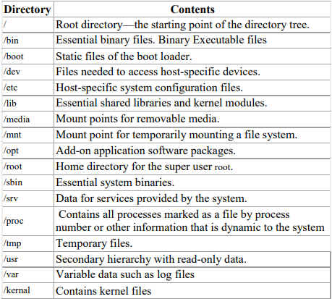
Understanding the Linux File System
SRM Institute of Science and Technology, Ramapuram

Slide 6
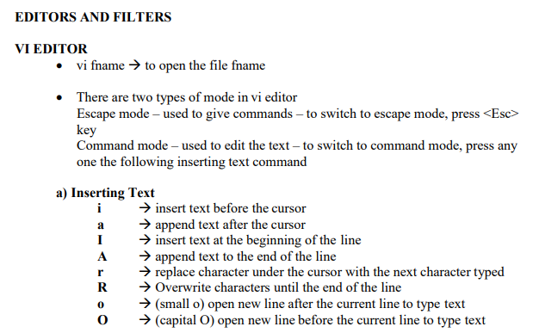
Understanding the Linux File System
SRM Institute of Science and Technology, Ramapuram

Slide 7
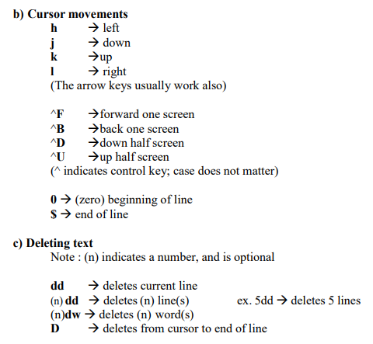
Understanding the Linux File System
SRM Institute of Science and Technology, Ramapuram

Slide 8
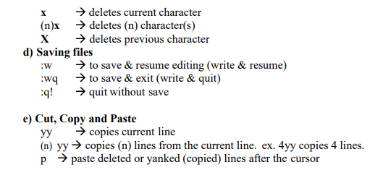
Understanding the Linux File System
SRM Institute of Science and Technology, Ramapuram

Slide 9
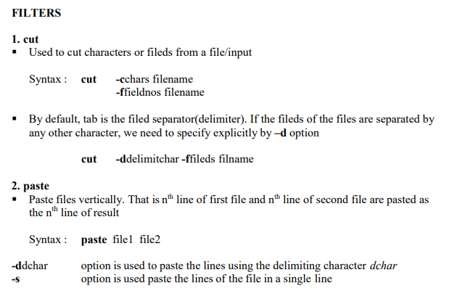
Understanding the Linux File System
SRM Institute of Science and Technology, Ramapuram

Slide 10
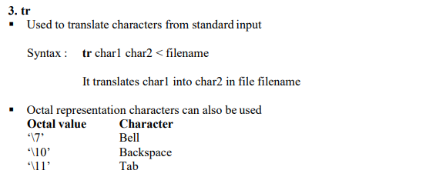
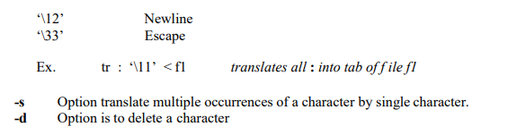
Understanding the Linux File System
SRM Institute of Science and Technology, Ramapuram

Slide 11
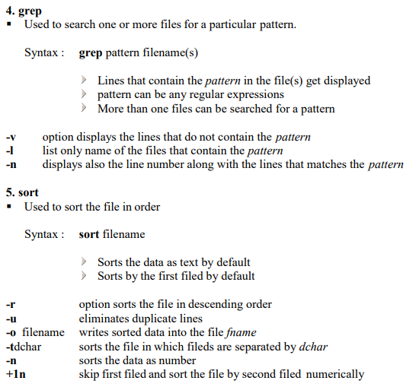
Understanding the Linux File System
SRM Institute of Science and Technology, Ramapuram

Slide 12
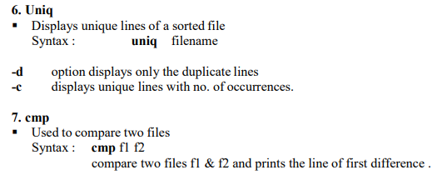
Understanding the Linux File System
SRM Institute of Science and Technology, Ramapuram

Slide 13
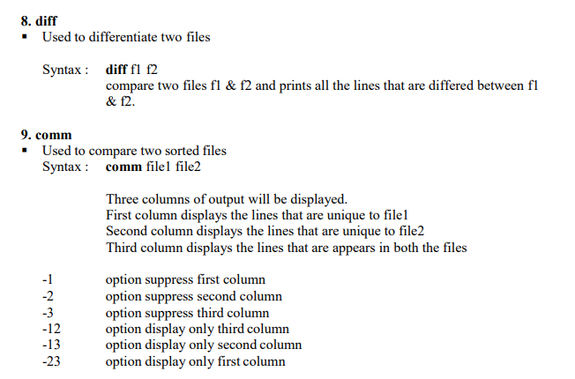
Understanding the Linux File System
SRM Institute of Science and Technology, Ramapuram

Slide 14
Understanding the Linux File System
Outcome: Learned and used various Linux file system, file system structure, VI editor and various filter commands in Linux and executed.
SRM Institute of Science and Technology, Ramapuram

